Slide 1

Introduction to Research Data Management
20th January 2016
Jonathan Rans
Digital Curation Centre
This work is licensed under the Creative Commons Attribution 2.5 UK: Scotland License.

Slide 2

Who we are
The (Est. 2004) is:
  A national-level centre of expertise in digital preservation with a particular focus on Research Data Management (RDM)
  Working closely with a number of UK institutions to boost RDM capability across the HE sector
  Also involved in a variety of national and international collaborations

Slide 3
What will we cover?
Definitions that we work to
Why take a formal approach to managing your data?
What does Research Data Management encompass?

Slide 4
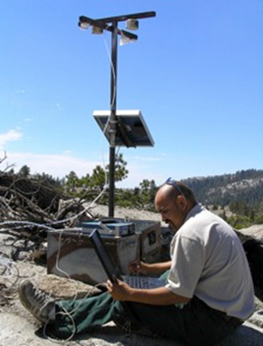
Why is RDM an issue?
Digital technology now used very widely in research, and is enabling new research and scientific paradigms
Research funders and publishers know that digital research data can be expensive to produce but inexpensive to share, making reuse more feasible and desirable
The challenge is to ensure digital research findings can be reproduced and cited
Notes:
There is a recognition that preservation skills which we have developed over hundreds of years are not sufficient to ensure the longevity of digital research material, which increasingly comprises the majority of the research record.

Slide 5


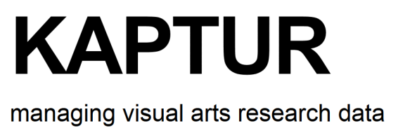
Definitions of research data?
“Research data, unlike other types of information is collected, observed, or created, for purposes of analysis to produce original research results.”
“Research data is defined as recorded factual material commonly retained by and accepted in the scientific community as necessary to validate research findings; although the majority of such data is created in digital format, all research data is included irrespective of the format in which it is created.“
“Evidence which is used or created to generate new knowledge and interpretations. ‘Evidence’ may be intersubjective or subjective; physical or emotional; persistent or ephemeral; personal or public; explicit or tacit; and is consciously or unconsciously referenced by the researcher at some point during the course of their research.”

Slide 6
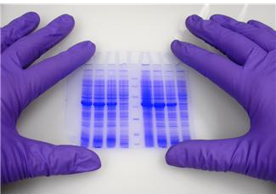

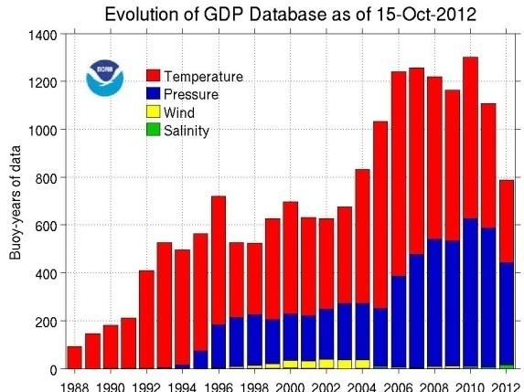


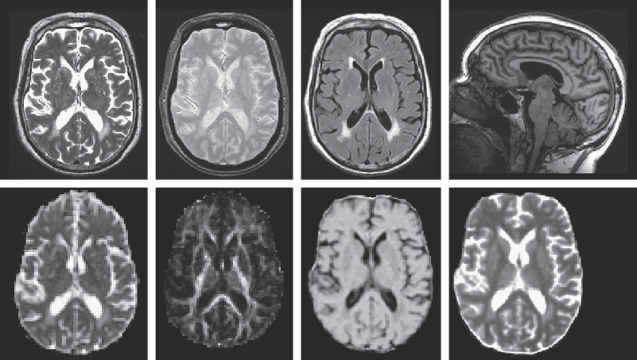

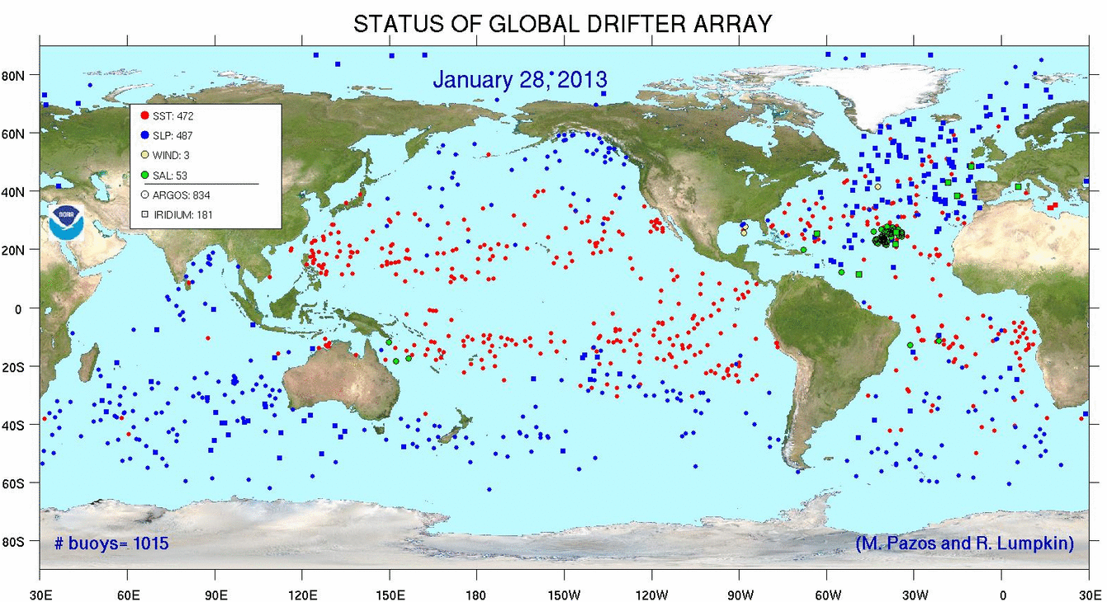
So, what might this include?
http://www.aoml.noaa.gov/phod/dac/array_growth.html
http://www.sbirc.ed.ac.uk/documents/lbc_protocol.pdf
Anything & everything produced in the course of research
http://www.aoml.noaa.gov/phod/graphics/dacdata/globpop.gif
Notes:
Instrument measurements
Experimental observations
Still images, video and audio
Text documents, spreadsheets, databases
Quantitative data (e.g. survey data)
Survey results & interview transcripts
Simulation data, models & software
Slides, artefacts, specimens, samples
Questionnaires
Sketches, diaries, lab notebooks …

Slide 7
What is research data management?
Plan
Create
Use
Appraise
Deposit and Publish
Discover and Reuse
“an explicit process covering the creation and stewardship of research materials to enable their use for as long as they retain value.”
Data management is part of
good research practice
Notes:
7

Slide 8
Why manage research data?
To make research easier!
To stop yourself drowning in irrelevant stuff
In case you need the data later
To avoid accusations of fraud or bad science
To share data so others can use and learn from it
To get credit for producing the data
Because somebody else said to do so
Notes:
Data is increasing in significance. It will unquestionably matter to your research careers, more than it does to your supervisors’ generation.
Learn good data habits now! You’ll need them later.

Slide 9
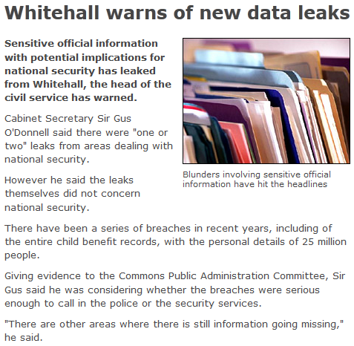
What if researchers data fell into the wrong hands?
http://news.bbc.co.uk/1/hi/uk/8332445.stm

Slide 10
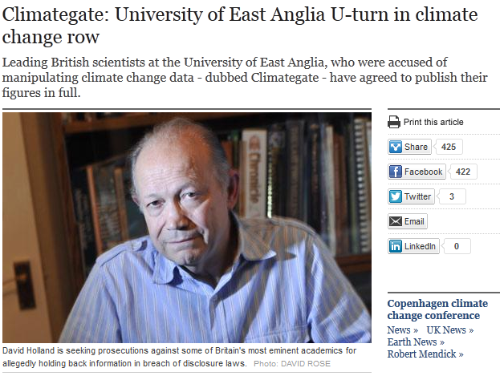
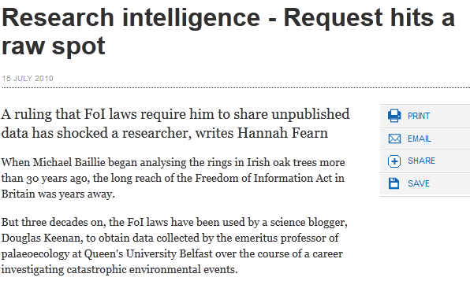


What if you had to produce a researcher’s data?

Slide 11
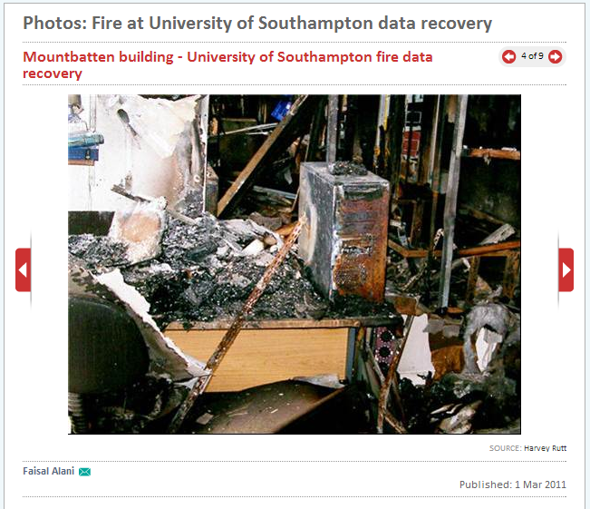
What is the worst-case scenario?
http://www.computerweekly.com

Slide 12
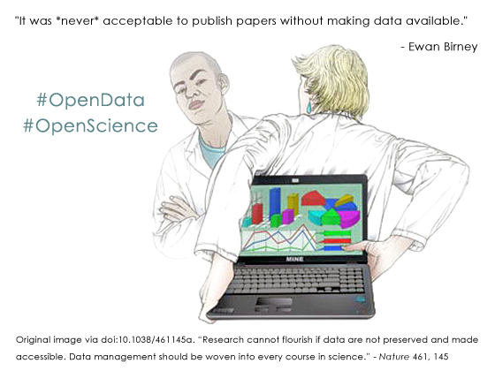
Why make data available?

Slide 13
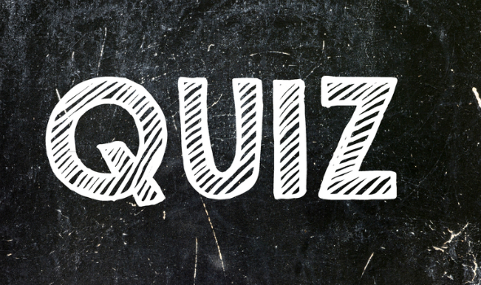
What do funders expect?

Slide 14
RCUK Common Principles in brief
Make data openly available where possible
Have policies & plans. Preserve data of long-term value
Metadata for discovery / reuse. Link to data from publications
Be mindful of legal, ethical and commercial constraints
Allow limited embargoes to protect the effort of creators
Acknowledge sources to recognise IP and abide by T&Cs
Ensure cost-effective use of public funds for RDM
www.rcuk.ac.uk/research/Pages/DataPolicy.aspx

Slide 15

Ultimately funders expect:
Data management plans
timely release of data
  once patents are filed or on (acceptance for) publication
open data sharing
  minimal or no restrictions if possible
preservation of data
  typically 5-10+ years if of long-term value
See the RCUK Common Principles on Data Policy:
www.rcuk.ac.uk/research/Pages/DataPolicy.aspx

Slide 16
What is involved in RDM?
Data Management Planning
Data creation
Annotating / documenting data
Analysis, use, versioning
Storage and backup
Publishing papers and data
Preparing for deposit
Archiving and sharing
Licensing
Citing…
Plan
Create
Use
Appraise
Deposit and Publish
Discover and Reuse

Slide 17
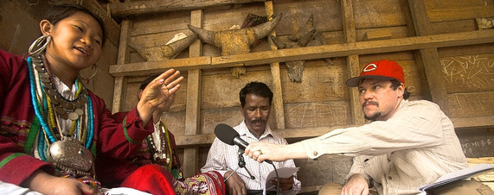
Active data management

Slide 18
Data creation
Adopt file naming conventions:
  http://www.jiscdigitalmedia.ac.uk/guide/choosing-a-file-name/
Design a good project folder structure
  http://research-data-toolkit.herts.ac.uk/document/research-project-file-plan/
Ensure consent forms, licences and partnership agreements don’t restrict opportunities to share data
  http://www.dcc.ac.uk/resources/how-guides/license-research-data
  http://www.data-archive.ac.uk/create-manage/consent-ethics/anonymisation

Slide 19
Some formats are better for long-term
It’s preferable to opt for formats that are:
Uncompressed
Non-proprietary
Open, documented
Standard representation (ASCII, Unicode)
Data centres may have preferred formats for deposit e.g.
Type | Recommended | Non-preferred
Tabular data | CSV, TSV, SPSS portable | Excel
Text | Plain text, HTML, RTF PDF/A only if layout matters | Word
Media | Container: MP4, Ogg Codec: Theora, Dirac, FLAC | Quicktime H264
Images | TIFF, JPEG2000, PNG | GIF, JPG
Structured data | XML, RDF | RDBMS
Further examples: http://www.data-archive.ac.uk/create-manage/format/formats-table
Notes:
Some formats are better for data sharing and long-term preservation than others.
It’s preferable to use formats that are uncompressed (e.g. large, high-quality files like .wav), non-proprietary (i.e. open) standards that are documented and well-understood. This aids preservation and interoperability.
Some data centres have preferred formats for deposit so it’s worthwhile encouraging researchers to consult these to check.

Slide 20
Where to store data?
Your own device (PC, flash drive, etc.)
  And if you lose it? Or it breaks?
Departmental drive or university filestore
  Should be more robust with automated back-up
“Cloud” storage
  Do they care as much about your data as you do?

Slide 21
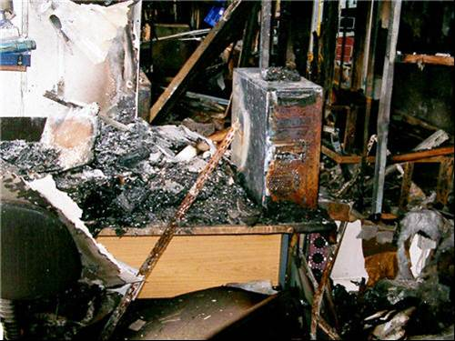
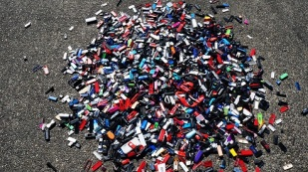

Storage and backup
Use managed services where possible e.g. shared drives rather than local or external hard drives
Consider the security implications of where you store data and how you transfer it
3… 2… 1… backup!
  at least 3 copies of a file
  on at least 2 different media
  with at least 1 offsite

Slide 22
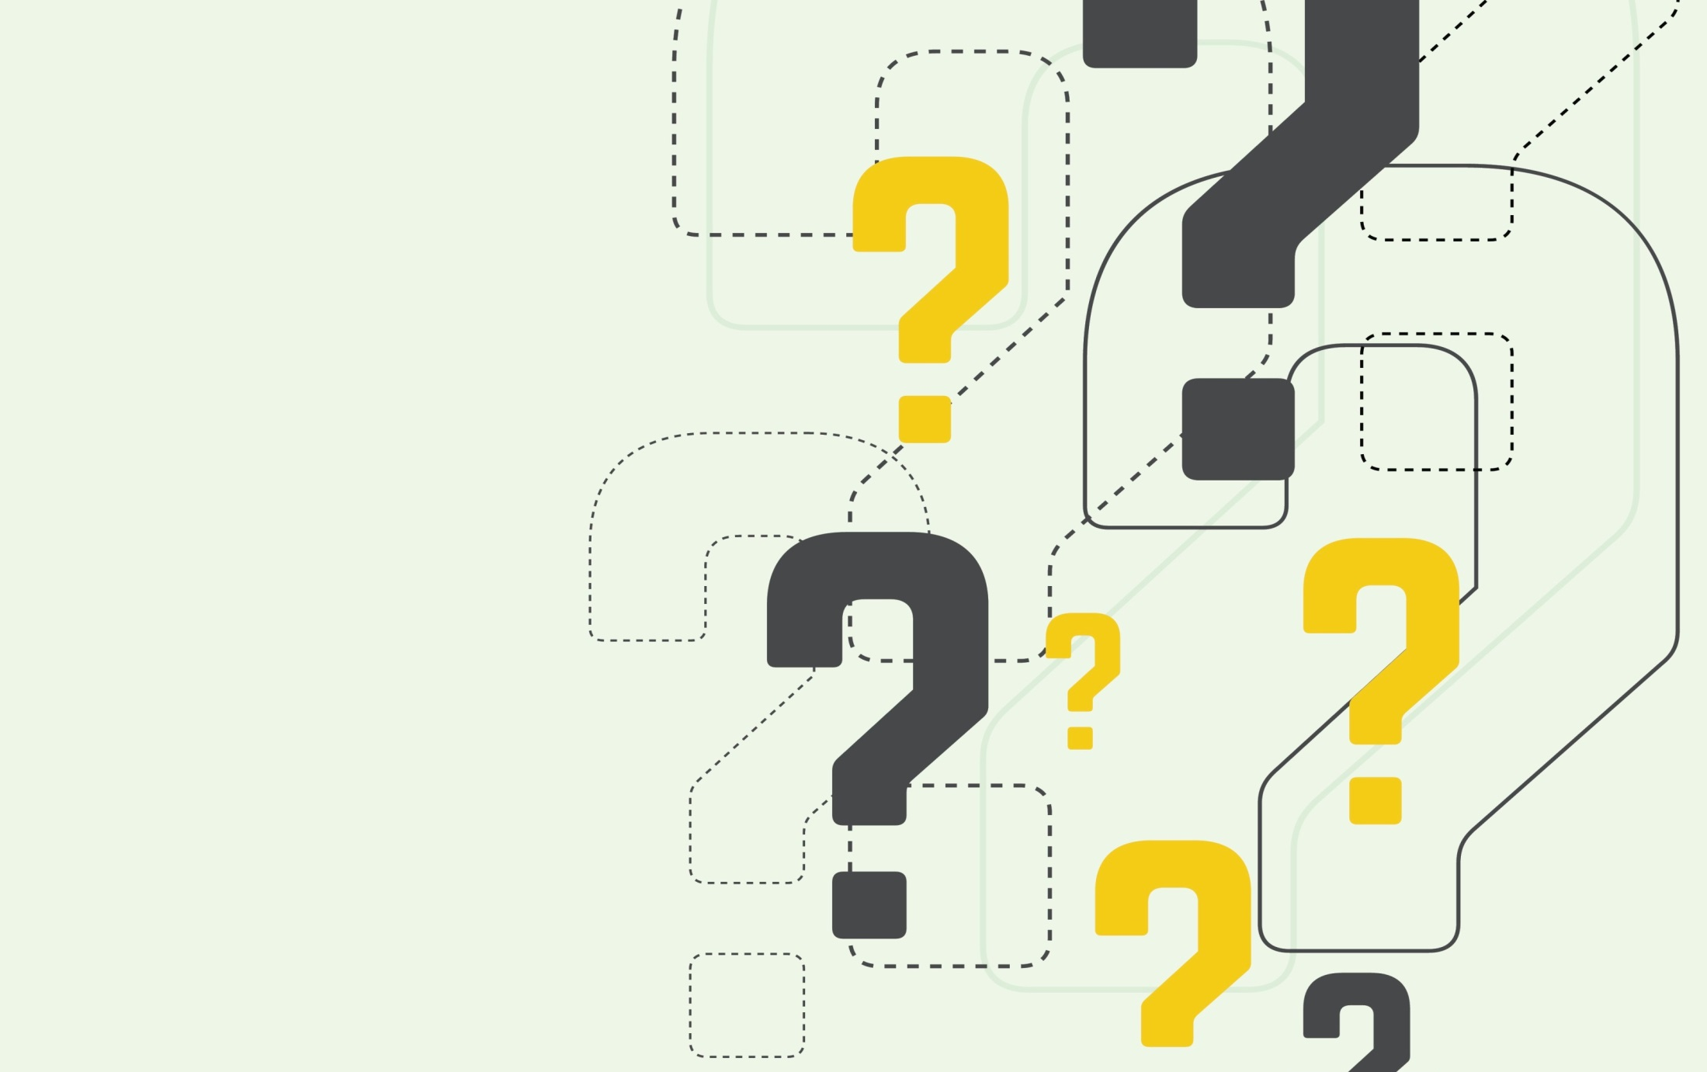
What is metadata?
Data aboutdata
Notes:
Documentation and metadata are essentially descriptive information about the information contained in a dataset. There should be good documentation at the study level, for example a description of the research methodology that created the data – [the best metadata the data can have is the publication it supports] or a data paper. There should also be documentation at the file, item and variable level suitable so that someone reusing the data can understand it – this could be ensuring that excel spreadsheets have sensible row and column descriptions or that a document is included with the dataset which properly explains any abbreviations used.

Slide 23
What is the difference?
Metadata
  Standardised
  Structured
  Machine and human readable
Documentation
Metadata
Notes:
Metadata is a subset of documentation
Documentation is a catch-all term which can include some very high-level, human-readable, loosely structured information about the dataset – for example a description of the laboratory method used to generate a set of results or a sketch book accompanying a work of sculpture. The term metadata has come to define a subset of documentation information that uses standardised terms and is presented in a structured way. This metadata will be in a form enabling it to be read by machines and/or may be presented in human readable form as well.

Slide 24
What metadata are we talking about?
It can be helpful to define research metadata by its use:
Metadata for CITATION
Metadata for DISCOVERY
Metadata enabling REUSE

Slide 25


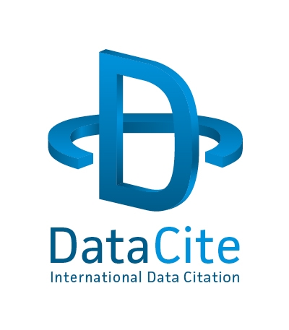
What is the minimum required?
Repository requirements
Funder requirements include Licencing/access conditions
Citation/disambiguation
  Identifier
  Creator
  Title
  Publisher
  Publication Year
Notes:
Potentially, the bare minimum of metadata required will be defined by the repository that accepts the dataset. This could correspond to the DataCite mandatory minimum metadata set although it is very likely that other elements will be required, whether by the repository or by the research funder. This metadata set is designed for citation and disambiguation, in other words ensuring that the dataset a researcher is reusing is identical to one cited in a journal article or online. This set of metadata does little to make the resource visible to researchers speculatively searching for relevant data to reuse.

Slide 26
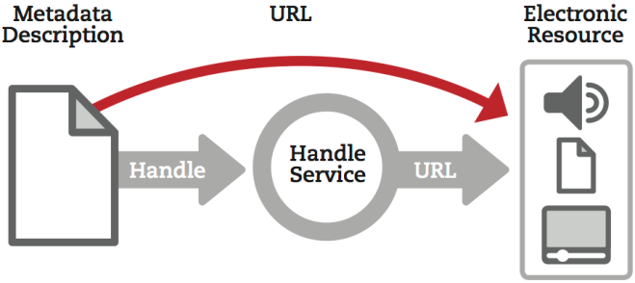
What are persistent identifiers?
Notes:
The likely home of an electronic research data resource attached to a persistent identifier is a data repository (exceptions being resources not available over the web which have a PI attached to a metadata record – physical resource, cumbersomely large dataset etc.)

Slide 27
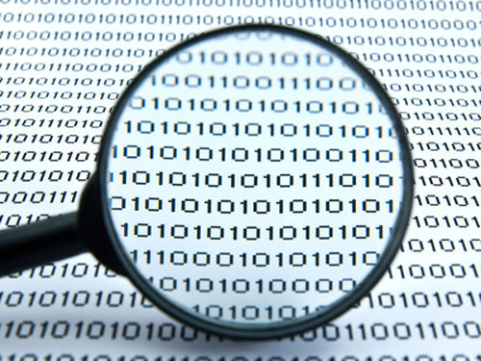
Aiding discoverability
Catalogue or discovery metadata
Structured so that search engines can uncover it.
Must be exposed in machine-readable form eg XML
Controlled vocabluaries
are helpful for keywords

Slide 28
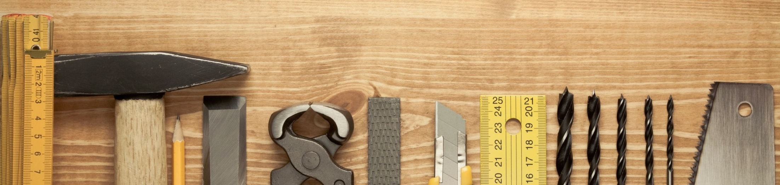
Ensuring the utility of the data
The what, why and how data creation must be understood
Data dictionaries
Columns/rows labelled
Variable ranges defined
Notes:
Ensuring that other researchers can understand and effectively reuse data that they access online without the help of the data’s creator is a more complicated task and requires a greater investment of effort to do successfully.

Slide 29
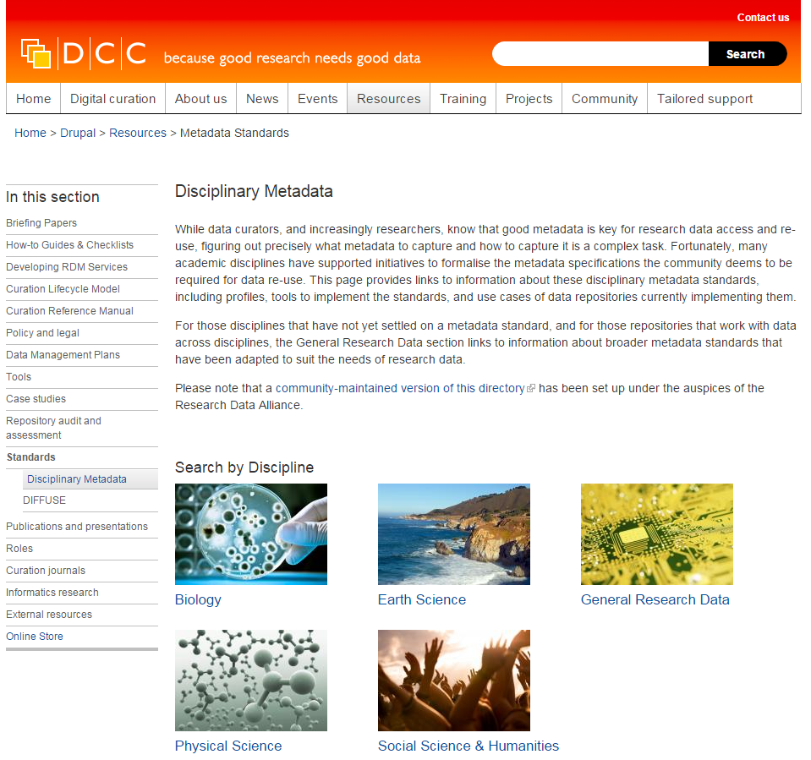
DCC metadata catalogue
The catalogue lists:
Metadata standards
Profiles
Use cases
Tools
http://www.dcc.ac.uk/drupal/resources/metadata-standards

Slide 30

Readme files
We recommend that a ReadMe be a plain text file containing the following:
for each filename, a short description of what data it includes, optionally describing the relationship to the tables, figures, or sections within the accompanying publication
for tabular data: definitions of column headings and row labels; data codes (including missing data); and measurement units
any data processing steps, especially if not described in the publication, that may affect interpretation of results
a description of what associated datasets are stored elsewhere, if applicable
whom to contact with questions
Notes:
These recommendations for developing a readme file were put together by the Dryad team and are published on the repository’s web-site.
http://datadryad.org/pages/readme

Slide 31
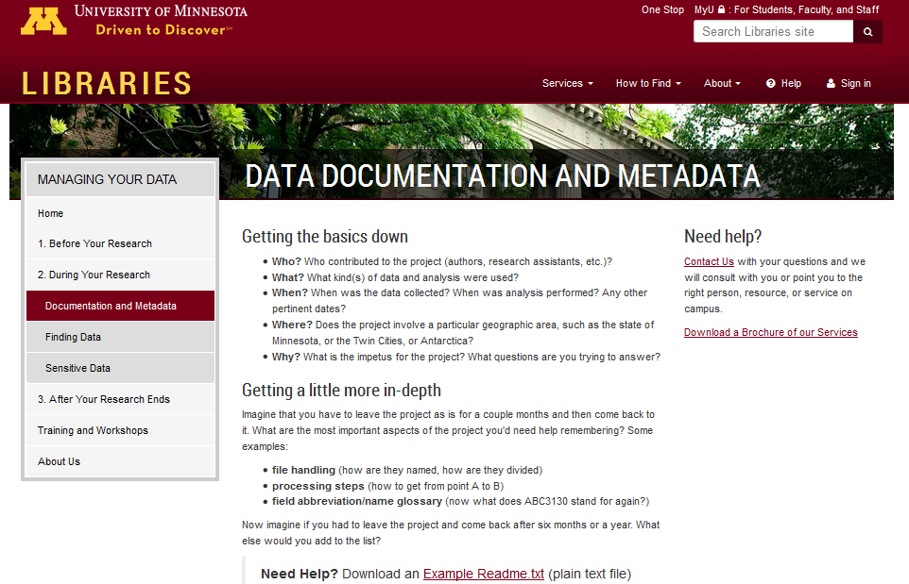
Readme – general example
https://www.lib.umn.edu/datamanagement/metadata

Slide 32
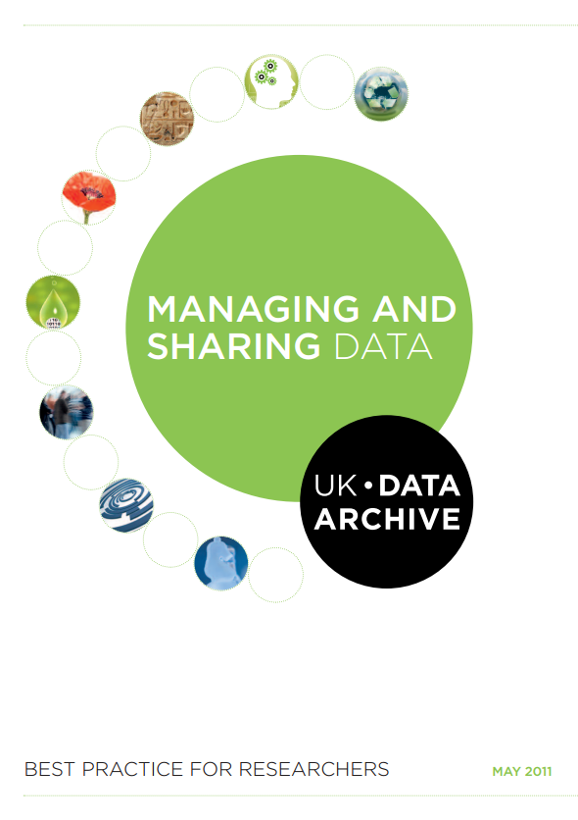
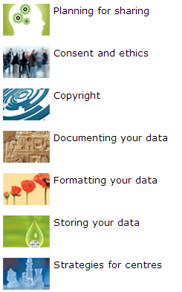
RDM and sharing : a best practice guide
http://data-archive.ac.uk/media/2894/managingsharing.pdf

Slide 33
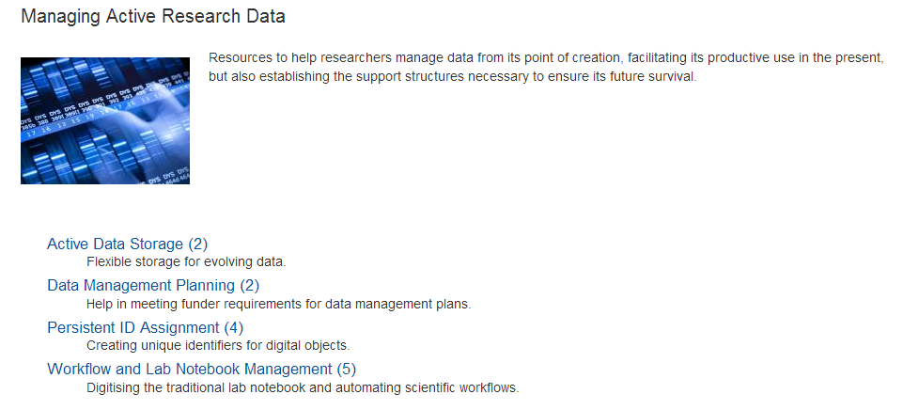


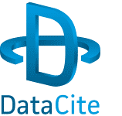


Tools for managing data
www.dcc.ac.uk/resources/external/tools-services/
managing-active-research-data

Slide 34


Questions?
Jonathan Rans
J.Rans@ed.ac.uk
@JNRans
Image Credits
Harvey Rutt, Southampton. Recovered from: http://www.computerweekly.com
Pile of flash drives: www.flashdrivepros.com
Dalian University fire: www.weirdworldnews.org
Metadata devil: http://www.truthdig.com/cartoon/item/nsa_its_just_metadata_20130812
Field researcher: http://www.nationalgeographic.com/mission/enduringvoices/expeditions.html

